Slide 1
ABC Trucking Case Study
Applying an audit plan from the source documentation

Slide 2
IRP Plan Section 1010 – Contents of Records
Records containing the following elements shall be accepted by the Base Jurisdiction as adequate under Section 1005(a):
For Records produced by a means other than a vehicle-tracking system:
(i) the beginning and ending dates of the trip to which the records pertain
(ii) the origin and destination of the trip
(iii) the route of travel
(iv) the beginning and ending reading from the odometer, hubodometer, engine control module (ECM), or any similar device for the trip
(v) the total distance of the trip
(vi) the distance traveled in each Jurisdiction
(vii) the Vehicle identification number or Vehicle unit number

Slide 3
IFTA Procedures Manual P540.200
Distance Records - Current language
An acceptable distance accounting system is necessary to substantiate the information reported on the tax return filed quarterly or annually. A licensee's system at a minimum, must include distance data on each individual vehicle for each trip and be recapitulated in monthly fleet summaries. Supporting information should include:
.005 Date of trip (starting and ending);
.010 Trip origin and destination;
.015 Route of travel (may be waived by base jurisdiction);
.020 Beginning and ending odometer or hubodometer reading of the trip (may be waived by base jurisdiction);
.025 Total trip miles/kilometers;
.030 Miles/kilometers by jurisdiction;
.035 Unit number or vehicle identification number;
.040 Vehicle fleet number;
.045 Registrant's name; and
.050 may include additional information at the discretion of the base jurisdiction.

Slide 4
NEW IFTA Procedures Manual – P540 Distance Records
Language effective January 1, 2017
.100 Distance records produced by a means other than a vehicle-tracking system that substantially document the fleet’s operations and contain the following elements shall be accepted by the base jurisdiction as adequate under this article:
.005 the beginning and ending dates of the trip to which the records pertain
.010 the origin and destination of the trip
.015 the route of travel
.020 the beginning and ending reading from the odometer, hubodometer, engine control module (ECM), or any similar device for the trip
.025 the total distance of the trip
.030 the distance traveled in each jurisdiction during the trip
.035 the vehicle identification number or vehicle unit number

Slide 5
What changes will there be with the new IFTA ballot that passed?
The removal of the following:
Route-of-travel or odometer reading being waived by the base jurisdiction.
Fleet number
Registrants name
Any other information deemed necessary by the licensee
This now mirrors the IRP language for manual recordkeeping requirements.

Slide 6
Manual Distance records

Slide 7
Discuss what manual distance source documents records are available and note any deficiencies. (Unit 13822)
Do the distance source documents provided overall meet the IFTA and IRP recordkeeping requirements?

Slide 8
What do you see wrong??

Slide 9
Odometer gaps between some trips
Only one destination location for each trip, but appears that either more than one drop is being made or a back haul is not being recorded
Last trip ends on 6/19

Slide 10
When comparing the Audited vs. Reported Distance they do not equal
What type of things do you see while you are auditing that could have created these types of errors?
Would you ask the carrier for an explanation or if more detailed records are available?
Would you project or isolate these errors?

Slide 11
Other distance issues you find with manual distance records:
Misreported distance between jurisdictions
Unreported jurisdictions
Distance per jurisdiction that doesn’t add up to total odometer distance
Missing trip sheets (large odometer gaps & how to allocate distance)

Slide 12
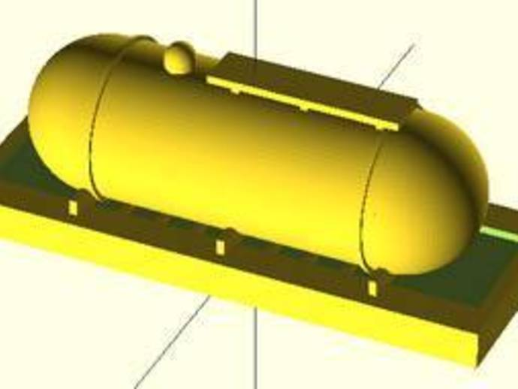
Manual & Electronic Fuel Records

Slide 13
IFTA Procedures Manual – P560 Tax-paid retail purchases
Current language
.100 Retail purchases must be supported by a receipt or invoice, credit card receipt, automated vendor generated invoice or transaction listing, or microfilm/microfiche of the receipt or invoice. Receipts that have been altered or indicate erasures are not accepted for tax-paid credits unless the licensee can demonstrate the receipt is valid.
.200 Receipts for retail fuel purchases must identify the vehicle by the plate or unit number or other licensee identifier, as distance traveled and fuel consumption may be reported only for vehicles identified as part of the licensee's operation.

Slide 14
IFTA Procedures Manual – P560 Tax-paid retail purchases (Cont.)
Current language
.300 An acceptable receipt or invoice must include, but shall not be limited to, the following:
.005 Date of purchase;
.010 Seller's name and address;
.015 Number of gallons or liters purchased;
.020 Fuel type;
.025 Price per gallon or liter or total amount of sale;
.030 Unit numbers; and
.035 Purchaser's name (See R1010.300 of the IFTA Articles of Agreement).

Slide 15
NEW IFTA Procedures Manual – Tax-paid retail purchases P550 Fuel Records
Language effective January 1, 2017
.110 Retail fuel purchases include all those purchases where a licensee buys fuel from a retail station or a bulk storage facility that the licensee does not own, lease, or control.
.200 The base jurisdiction shall not accept, for purposes of allowing tax-paid credit, any fuel record that has been altered, indicates erasures, or is illegible, unless the licensee can demonstrate that the record is valid.
.210 The base jurisdiction shall not allow tax-paid credit for any fuel placed into a vehicle other than a qualified motor vehicle.

Slide 16
NEW IFTA Procedures Manual – Tax-paid retail purchases P550 Fuel Records (Cont.)
.220 The base jurisdiction shall not allow a licensee credit for tax paid on a retail fuel purchase unless the licensee produces, with respect to the purchase:
.005 a receipt, invoice, or transaction listing from the seller,
.010 a credit-card receipt,
.015 a transaction listing generated by a third party, and
.020 an electronic or digital record of an original receipt or invoice.

Slide 17
NEW IFTA Procedures Manual – Tax-paid retail purchases P550 Fuel Records (Cont.)
.300 For tax-paid credit, a valid retail receipt, invoice, or transaction listing must contain:
.005 the date of the fuel purchase
.010 the name and address of the seller of the fuel (a vendor code, properly identified, is acceptable for this purpose)
.015 the quantity of fuel purchased
.020 the type of fuel purchased
.025 the price of the fuel per gallon or per liter, or the total price of the fuel purchased
.030 the identification of the qualified motor vehicle into which the fuel was placed
.035 the name of the purchaser of the fuel (where the qualified motor vehicle being fueled is subject to a lease, the name of either the lessor or lessee is acceptable for this purpose, provided a legal connection can be made between the purchaser named and the licensee)

Slide 18
What changes will there be with the new IFTA ballot that passed?
Retail fuel purchases include all those purchases where a licensee buys fuel from a retail station or a bulk storage facility that the licensee does not own, lease, or control.
There are no changes to the items required on a retail fuel source document.

Slide 19
Discuss how the licensee is obtaining fuel and what records are available for this audit.
Do the fuel source documents meet the IFTA requirments?

Slide 20
What do you see wrong?

Slide 21
March 28-31 purchases were reported in 2nd Qtr., 2015.
March 28-31 purchases were not included on the fuel card statements provided.
One fuel receipt provided doesn’t list the unit number
4/7 fuel purchase recorded on driver’s trip sheet but not on either fuel statement.
4/26 fuel purchase recorded on local vendor statement that is not recorded on trip sheet (odometer reading not of this unit).
5/6 fuel purchase (Marion, IN) recorded on the fuel card statement but not recorded on any trip sheet.

Slide 22
5/6 fuel purchase location
Marion, IN
5/8 trip to WA
Jasper, IN

Slide 23
When comparing the Audited vs. Reported Gallons differences were found
What would you do with the unsupported fuel purchase?
Would you project these errors or isolate?
Would you expand any of your search to other units or quarters to see if the errors are recurring?

Slide 24
Other fuel issues you frequently find that were not in this case study:
Prepay fuel receipts
Bulk fuel
Fuel Receipts without dates or vendor information
DEF and Reefer Fuel

Slide 25
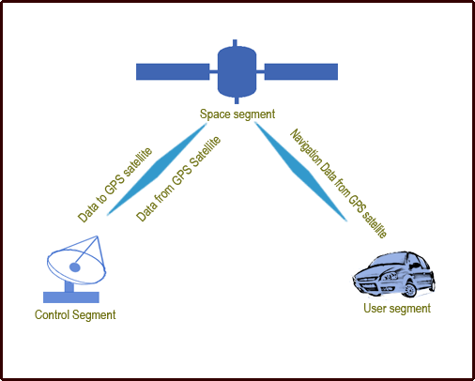
Vehicle Tracking System Records

Slide 26
IRP Plan Section 1010 (b)
(b) For Records produced wholly or partly by a vehicle-tracking system, including a system based on a global positioning system (GPS):
the original GPS or other location data for the Vehicle to which the Records pertain
the date and time of each GPS or other system reading
the location of each GPS or other system reading
the beginning and ending reading from the odometer, hubodometer, engine control module (ECM), or any similar device for the period to which the Records pertain
the calculated distance between each GPS or other system reading
the route of the Vehicle’s travel
the total distance traveled by the Vehicle
the distance traveled in each jurisdiction
the Vehicle identification number or Vehicle unit number

Slide 27
IFTA Procedures Manual P640 – Data Collection Requirements
Current Language
.100 Required Trip Data
.005 Date of Trip (starting and ending);
.010 Trip origin and destination (location code is acceptable);
.015 Routes of travel or latitude/longitude positions used in lieu thereof (may be waived by base jurisdiction).
.020 Beginning and ending odometer or hubodometer reading of the trip (may be waived by base jurisdiction);
.025 Total trip distance;
.030 Distance by jurisdiction;
.035 Power unit number or vehicle identification number;
.040 Vehicle fleet number; and
.045 Registrant's name.

Slide 28
New IFTA Procedures Manual P540 – Distance Records
Language effective January 1, 2017
.200 Distance records produced wholly or partly by a vehicle-tracking system, including a system based on a global positioning system (GPS):
.005 the original GPS or other location data for the vehicle to which the records pertain
.010 the date and time of each GPS or other system reading, at intervals sufficient to validate the total distance traveled in each jurisdiction
.015 the location of each GPS or other system reading
.020 the beginning and ending reading from the odometer, hubodometer, engine control module (ECM), or any similar device for the period to which the records pertain
.025 the calculated distance between each GPS or other system reading
.030 the route of the vehicle’s travel
.035 the total distance traveled by the vehicle
.040 the distance traveled in each jurisdiction
.045 the vehicle identification number or vehicle unit number

Slide 29
What changes will there be with the new IFTA ballot that passed?
Routes of travel and beginning & ending odometer/ hubodometer readings may NOT be waived by the jurisdiction
Removed requirement for vehicle fleet number and registrant’s name
NOTE: This now mirrors the IRP language for electronic vehicle tracking systems.

Slide 30
Discuss what GPS records are available
Do you think that the electronic records provided meet the requirements for the IFTA and IRP?
Note any questions that you would have for the carrier/licensee or issues you see with the records.

Slide 31
What questions do you have?

Slide 32
Does not list total distance or distance by jurisdiction by trip (current IFTA requirement, but not under the new language).
Does not combine the toll and non-toll miles into one total (no total miles).
Does not show distance per jurisdiction on each line even though more than one jurisdiction is listed
The distance per the odometer readings does not always agree with the GPS miles – How are the odometer readings obtained?
Each data line is a range of activity vs. listing the information for a single “ping”.

Slide 33
Other frequently asked questions when dealing with GPS systems:
What type of GPS system do you have? Is the same GPS system on all of your units?
How often does the GPS send a signal? (transmits a “ping”)
What information is the GPS recording? (i.e. date, location points, odometer reading, fuel stops, when the engine is turned off, some sort of “event”, etc.)
If your GPS system records odometer readings, at what points are the odometer readings being captured?
How does your GPS system calculate distance? Does it use Geofencing?
Do you use other computer software in addition to your GPS that calculates distance? If so, what type of software do you use?

Slide 34
Other frequently asked questions when dealing with GPS systems (Cont.):
Can reports be printed or made available listing the total & jurisdiction distance per trip or day, and the detail of the GPS location points (including latitude & longitude) for each trip or day?
How long do you retain your GPS information?
Is the GPS information being edited? If yes, why would the information be edited? What information is being edited?
Is the GPS system “hard-wired” into the truck’s ECM?
Can the driver defeat or tamper with the GPS system?
Are you alerted when the GPS system is not receiving a signal from a unit or if there is a problem with the signal?
What is your procedure or policy of recording distance information if the GPS system were to malfunction?

Slide 35
Questions???

